Slide 1
Introduction to
Global Navigation Satellite Systems
Ondrej Kútik

Slide 2
Agenda
History
Signal characteristics
Other systems
Start
2
3
4
5
6
End
1
Basic principle
Receiver
Q & A

Slide 3
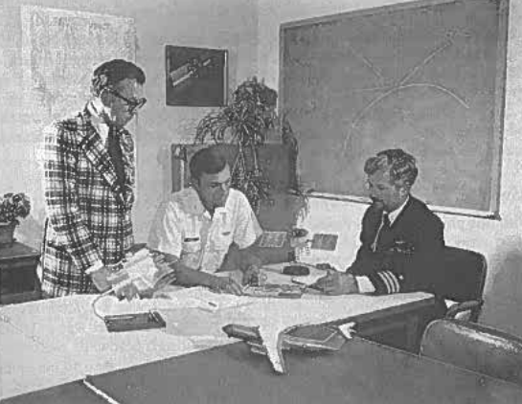
GPS History
Started in 1960s
GPS initiated in 1972
1983 granted civilian use
Operational since 1993 (24 satellites)
30 satellites in orbit today
Yearly budget $500 - $1000 million
750 000 receivers sold annually
Source: The Global Positioning System, Parkinson

Slide 4
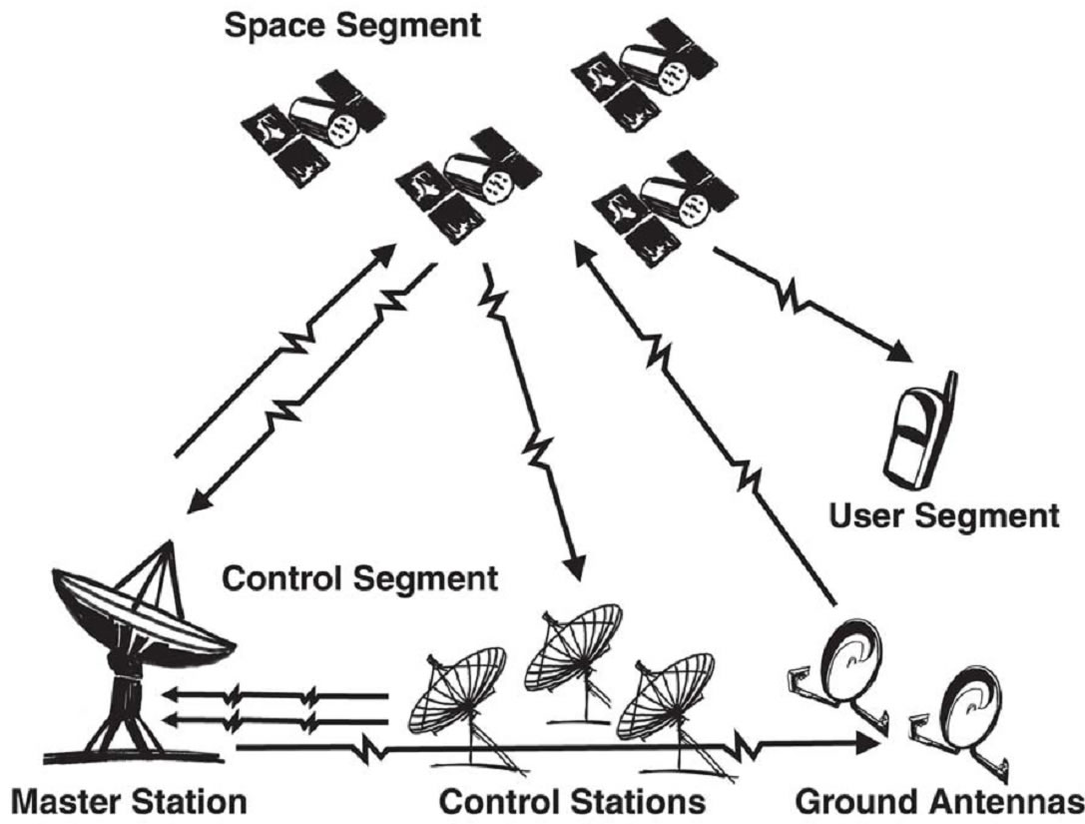
Global Positioning System
Space segment
Control segment
User segment
Source: connet.us

Slide 5

Basic Principle
Y-coordinates
s = v∙t
X-coordinates

Slide 6
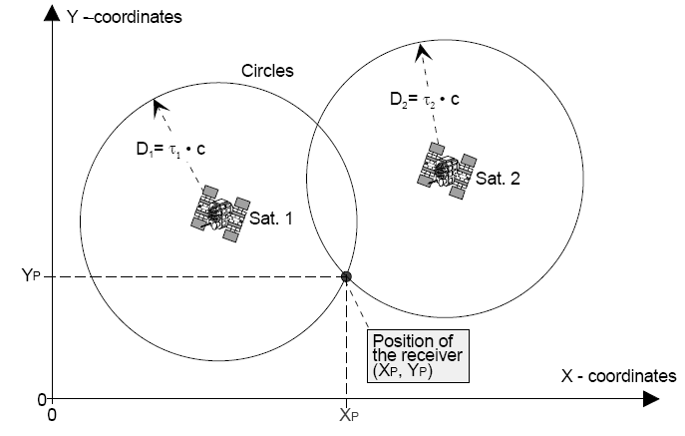
Basic principle

Slide 7
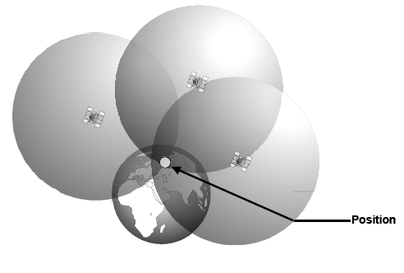
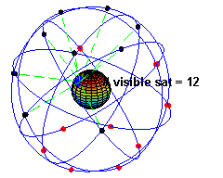
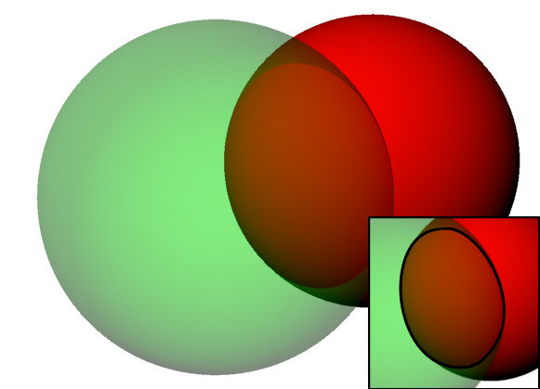
Basic principle
  For two satellites, intersecting those surfaces gives a circle
  For three satellites we get the receiver position
  Forth satellite to resolve time
  Most of the time there are more than 4 satellites on view
Source: Wikipedia

Slide 8
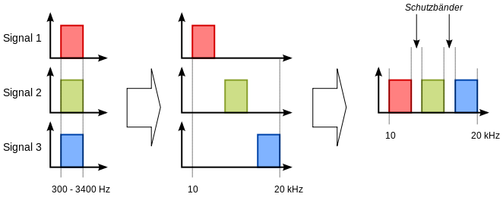
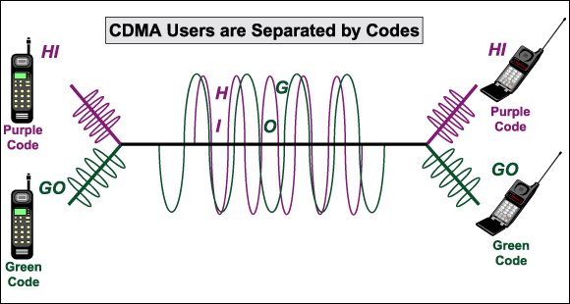
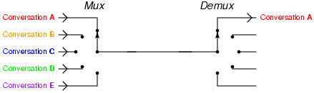
Multiplexing
Channel sharing
  Time multiplex
  Frequency multiplex
  Code multiplex, Spreading Codes
Source: Wikipedia

Slide 9
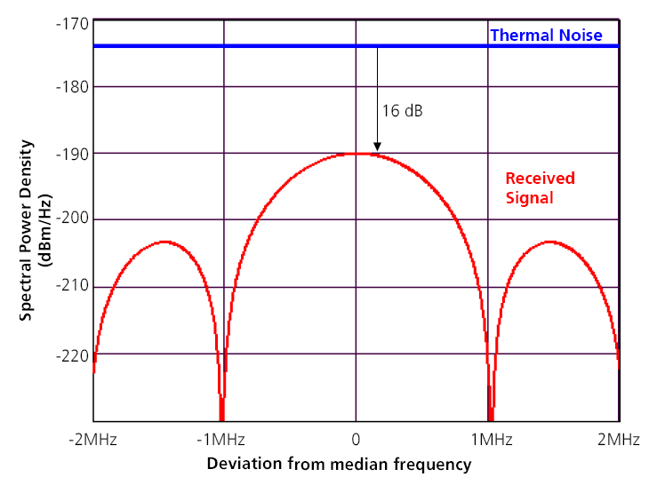
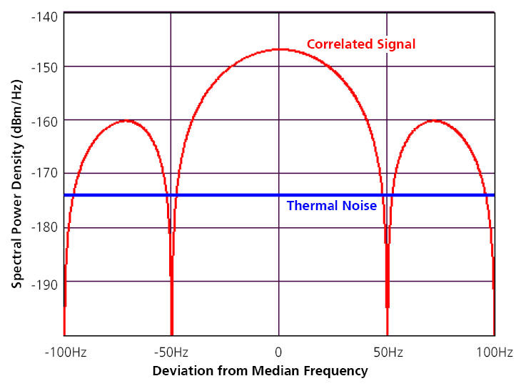
Spectral Power of Receiver Signal
The maximum received signal power is approximately 16dB below the thermal background noise level
After despreading, the power density of the usable signal is greater than that of the thermal or background signal noise

Slide 10
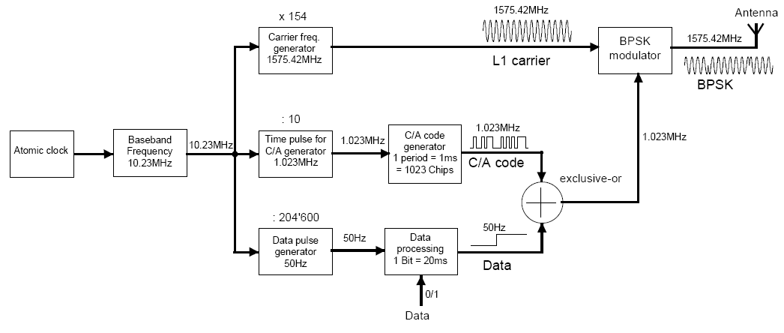
GPS L1 C/A Signal Generation
Carrier frequency 1575.42 GHz
Spreading code with 1ms period
Data 50 bps
  Timestamp, Satellite position, Corrections, …

Slide 11
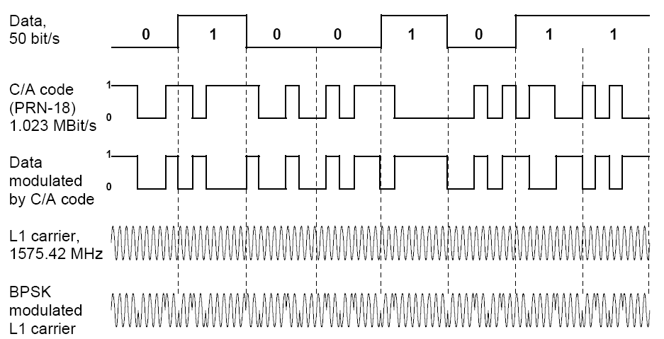
GPS L1 C/A Signal Generation
Example of carrier, data and CDMA primary code combination.

Slide 12
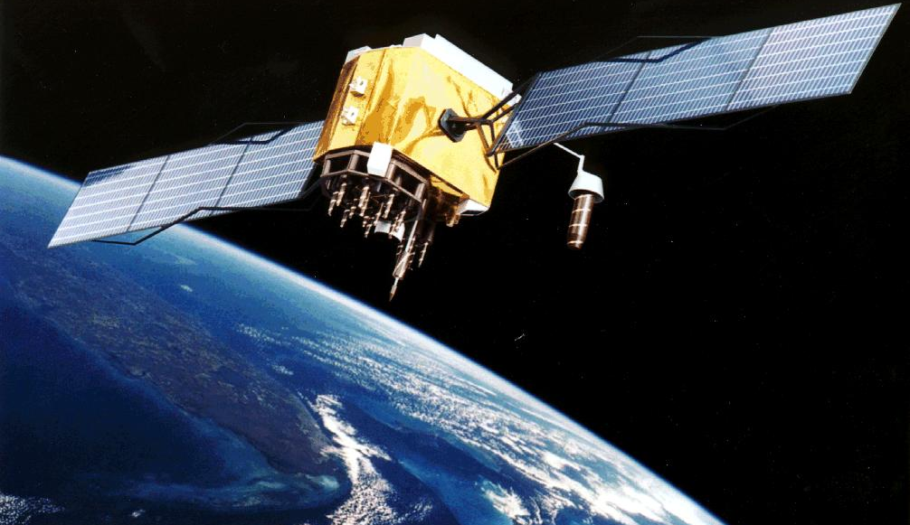
Satellite
Around 1000 Kg and 20m in length
Speed about 14000 km/h
20000 km above Earth
Rubidium clock controlled by more accurate ground based Cesium clocks
100,000 years to see it gain or lose a second
Quartz watch loses a second every 2 days
Picture: Wikipedia

Slide 13
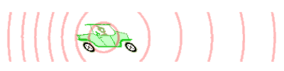
Doppler Effect
Moving source (or receiver) changes frequency
Source: Wikipedia

Slide 14
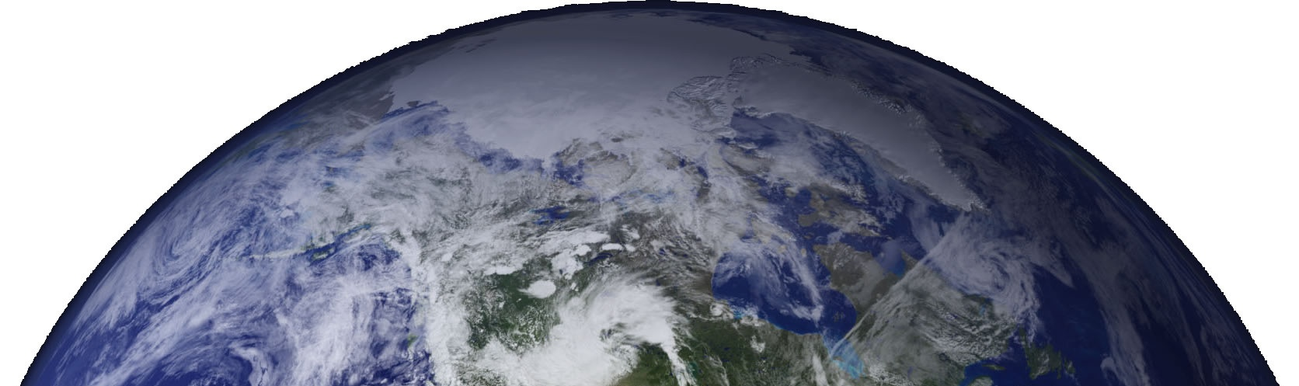

Doppler Effect
Moving source (or receiver) changes frequency

Slide 15
Signal Space
1023
~1 ms
Code
1575.42
Frequency [MHz]

Slide 16
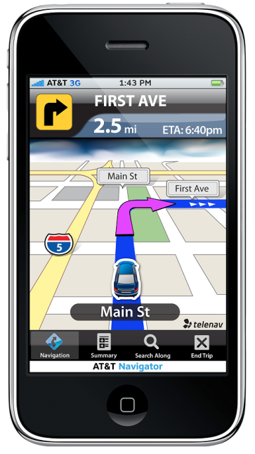
Receiver
Acquisition
Initial carrier and code rate
Tracking
Track signal
Nav bits
Decoding
Decode nav message
PVT
Position, Velocity and Time

Slide 17
Receiver
Acquisition
Initial carrier and code rate
Tracking
Track signal
Nav bits
Decoding
Decode nav message
PVT
Position, Velocity and Time

Slide 18
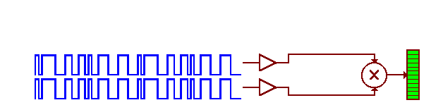
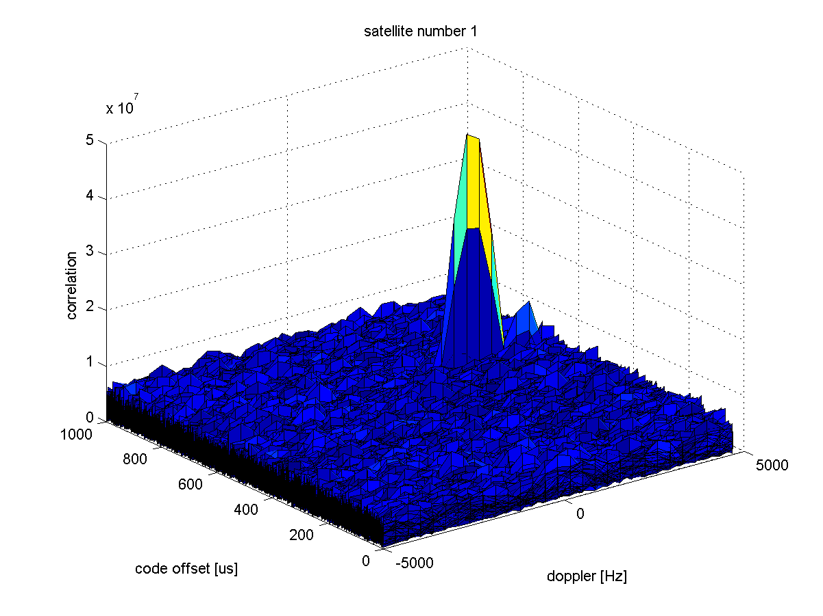
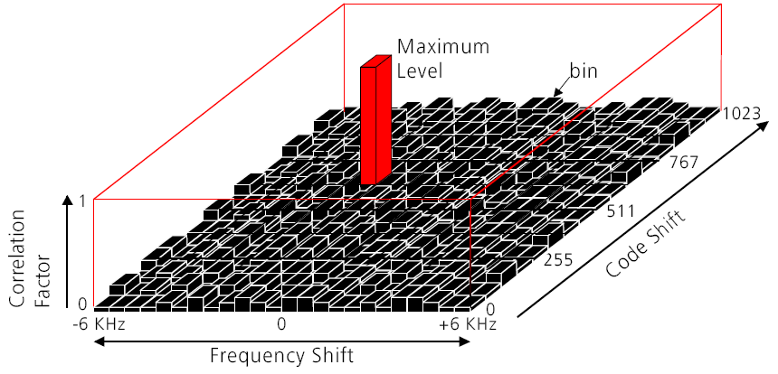
Acquisition
Search for the maximum correlation in the code and carrier frequency domains
Results of acquisition on L5I signal in a 3D plot
  Based on real data
  Performed with Matlab script
  Code shift range function of primary code length
  Frequency shift range function of max Doppler + clock max drift
  Correlating incoming signal with local replica

Slide 19
Receiver
Acquisition
Initial carrier and code rate
Tracking
Track signal
Nav bits
Decoding
Decode nav message
PVT
Position, Velocity and Time

Slide 20
Tracking
Update period 1ms
Adjust carrier frequency and code rate
Decode bits

Slide 21
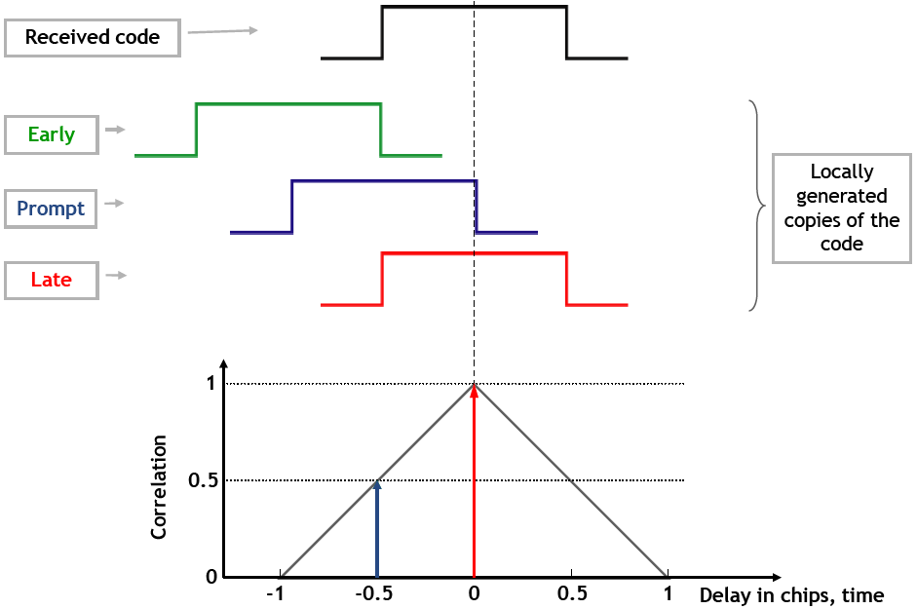
Code Discriminator
When the internally generated and incoming CDMA codes are aligned, there is a peak in the correlation of both signals
  The correlation is computed at 3 points, early, prompt and late
  These values are used then used in the discriminator to advance or delay the internally generated code

Slide 22
Receiver
Acquisition
Initial carrier and code rate
Tracking
Track signal
Nav bits
Decoding
Decode nav message
PVT
Position, Velocity and Time

Slide 23
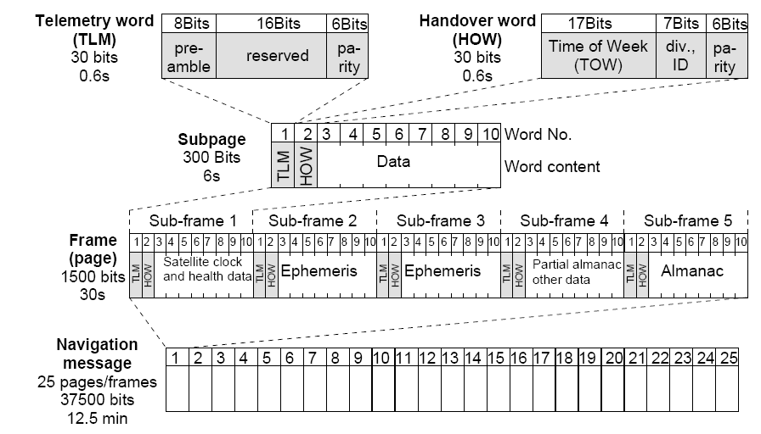
Decoder

Slide 24
Receiver
Acquisition
Initial carrier and code rate
Tracking
Track signal
Nav bits
Decoding
Decode nav message
PVT
Position, Velocity and Time

Slide 25
Pseudorange
Pseudo-distance between receiver and satellite
ρ_{raw} = (Time of Reception – Time of Transmission) * c
1μs = 300 meter error
Time of Transmission
Satellite
Transmission
Time
Clock diff
Receiver
Time of Reception

Slide 26
Pseudorange
Pseudo-distance between receiver and satellite
ρ_{raw} = (Time of Reception – Time of Transmission) * c
Satellite 1
TOW
Satellite 2
TOW
Satellite 3
TOW
Satellite 4
TOW
Time of Reception
Time of Reception

Slide 27
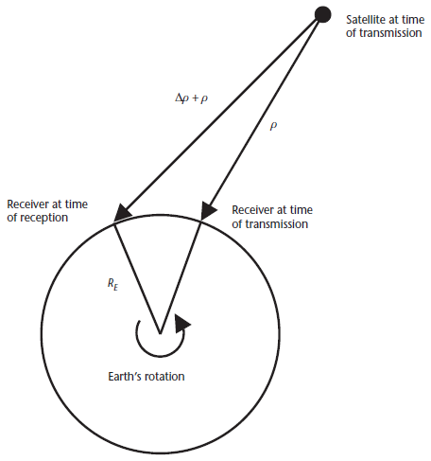
Corrections – Sagnac Effect
Due to rotation of the Earth during the time of signal transmission
If the user experiences a net rotation away from the SV, the propagation time will increase, and vice versa.
If left uncorrected, the Sagnac effect can lead to position errors on the order of 30m
Source: Understanding GPS principles, Kaplan

Slide 28

Corrections – Relativistic
Satellite speed
  Relativistic time dilation leads to an inaccuracy of time of approximately 7,2 microseconds per day
  1μs = 300 meter error
Gravity
  Time moves slower at stronger gravity
  10.229999995453 MHz instead of 10.23 MHz
Source: damtp.cam.ac.uk

Slide 29
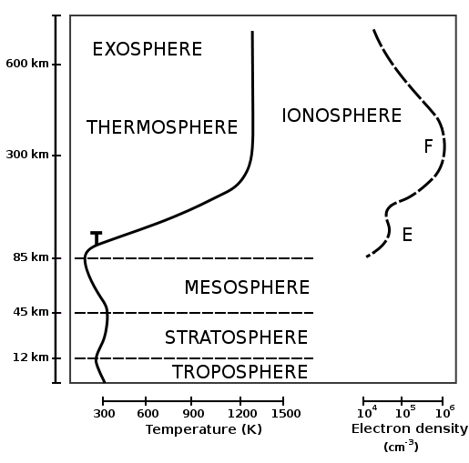
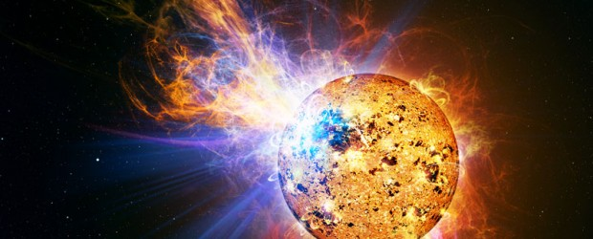
Ionosphere
Ionized by solar radiation
Causing propagation delay
Scintillation
Source: Wikipedia

Slide 30
Ionosphere - Mitigation
Single frequency
  Klobuchar model
Dual frequency combination
  Delay is frequency dependent

Slide 31
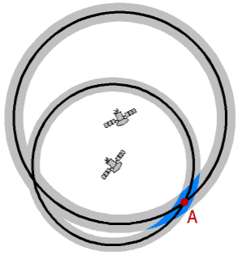
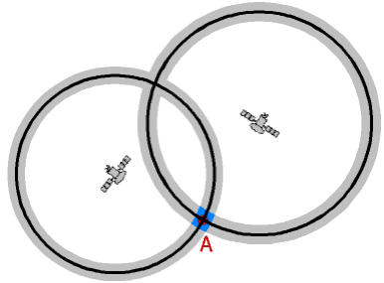
Errors – Satellite Geometry
Dilution of position
  Select satellites that minimize DOP
Source: www.kowoma.de

Slide 32
Error Budget
Error Type | One-Sigma error (meters) | Segment
Ephemeris | 2.0 | Signal-In-Space
Satellite Clock | 2.0 | Signal-In-Space
Ionosphere | 4.0 | Atmosphere
Troposphere | 0.7 | Atmosphere
Multipath | 1.4 | Receiver
Receiver Noise | 0.5 | Receiver
Dilution of Precision | 1-6

Slide 33
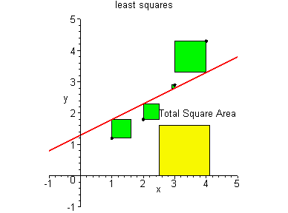
Least Square
∆ρ – delta pseudorange
H – nx4 matrix
H ∆x = ∆ρ
∆x = H−1 ∆ρ
Weight Least Square
Kalman filter
Source: pages.central.edu

Slide 34
Pseudorange Corrections
T_{GD}
Relativistic corrections
Clock correction
SV clock error
Group delay
Relativistic effects
Tropo Model
Iono Model
GPS Time
Pseudorange
WLS
Position
Velocity
Time
Geometric Delay
Ionosphetic Delay
Tropospheric Delay
User CLK Bias
GPS Time

Slide 35
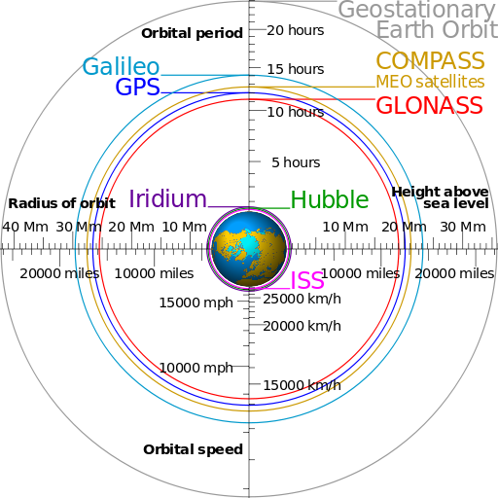
Other Global Navigation Satellite Systems
System | Political entity | Multiplexing | Number of satellites
GPS | USA | CDMA | Min 24 (31)
GLONASS | Russia | FDMA / CDMA | 31 (24)
COMPASS | China | CDMA | 5 GEO + 30 MEO
Galileo | EU | CDMA | 30 (4+2)
Source: Wikipedia

Slide 36
Comparison of GNSS Signals
Constellation | Signal | Frequency [GHz] | Modulation | Multiplexing
GPS | L1 C/A | 1575.42 | BPSK | CDMA
 | L1 C | 1575.42 | TMBOC | CDMA
 | L5 | 1176.45 | BPSK | CDMA
Galileo | E1 | 1575.42 | CBOC | CDMA
 | E5a | 1176.45 | AltBOC | CDMA
 | E5b | 1207.14 | AltBOC | CDMA
Compass | B1 | 1561.098 | QPSK | CDMA
 | B2 | 1207.14 | BPSK | CDMA
Glonass | L1OF | 1602 + n×0.5625 | BPSK | FDMA
 | L1OC | 1575.42 | BOC | CDMA

Slide 37
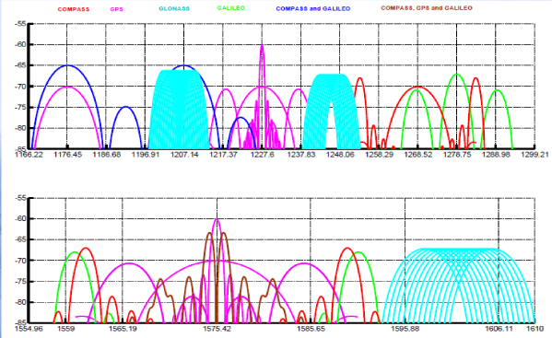
Spectrum
Source: insidegnss.com

Slide 38
Questions?

Slide 39
Back up slides

Slide 40
Title

Slide 41
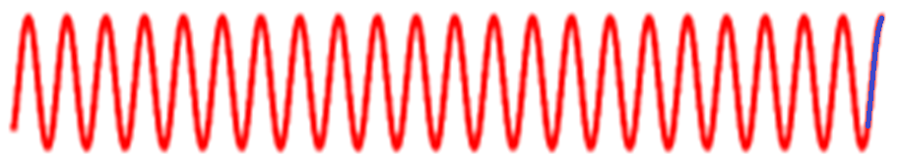
Carrier Measurement
Measure number of carrier periods plus phase change
    r_{carrier} = (N + ∆Θ) λ
Accurate but ambiguous

Slide 42
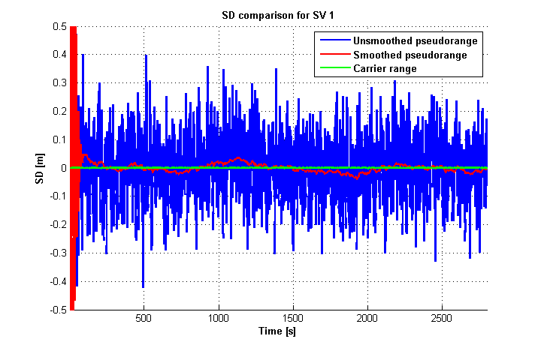
Smoothing

Slide 43
Carrier Aiding
Doppler effect on both code and carrier (f₁ / f₂)
Use accurate estimate from PLL to aid DLL
Further reduce filter BW
Nominal Carrier Rate
Phase Discriminator
Estimated Carrier Error
PLL
Estimated Carrier Rate
Scale Factor
Code Discriminator
Estimated Code Error
DLL
Estimated Code Rate
Nominal Code Rate

